Slide 1
WATER CLEANING ROBOT
(W- BOT)

Slide 2
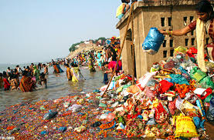
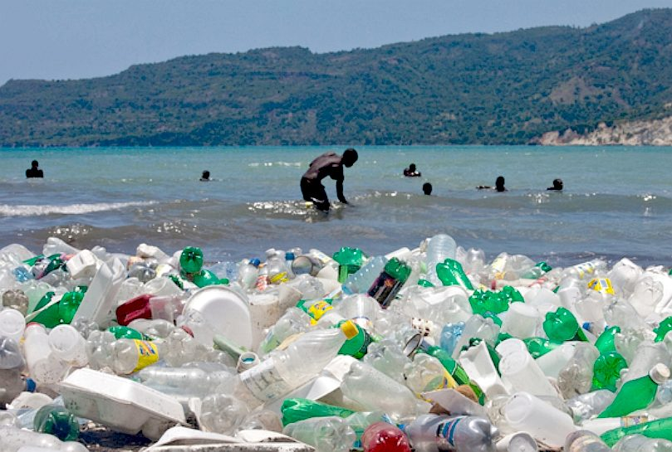
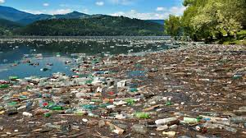
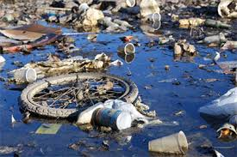

UNDERSTANDING THE PROBLEM

Slide 3
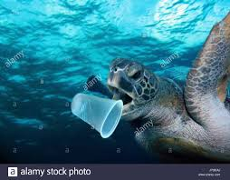
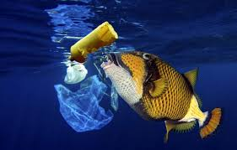
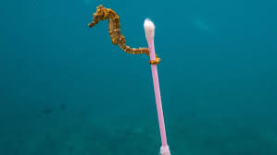
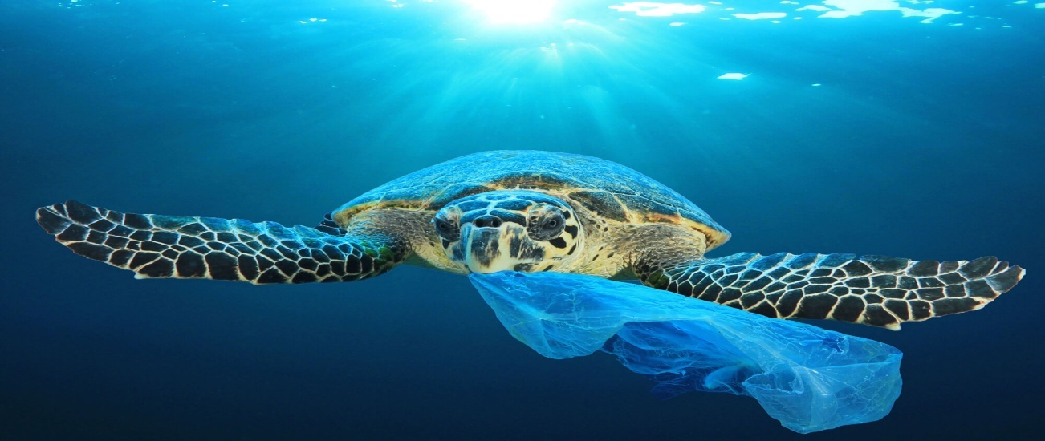
* According to a survey more than 700 million species die due to plastic consumption. *And more than 100 million marine mammals die due to the same problem.

Slide 4
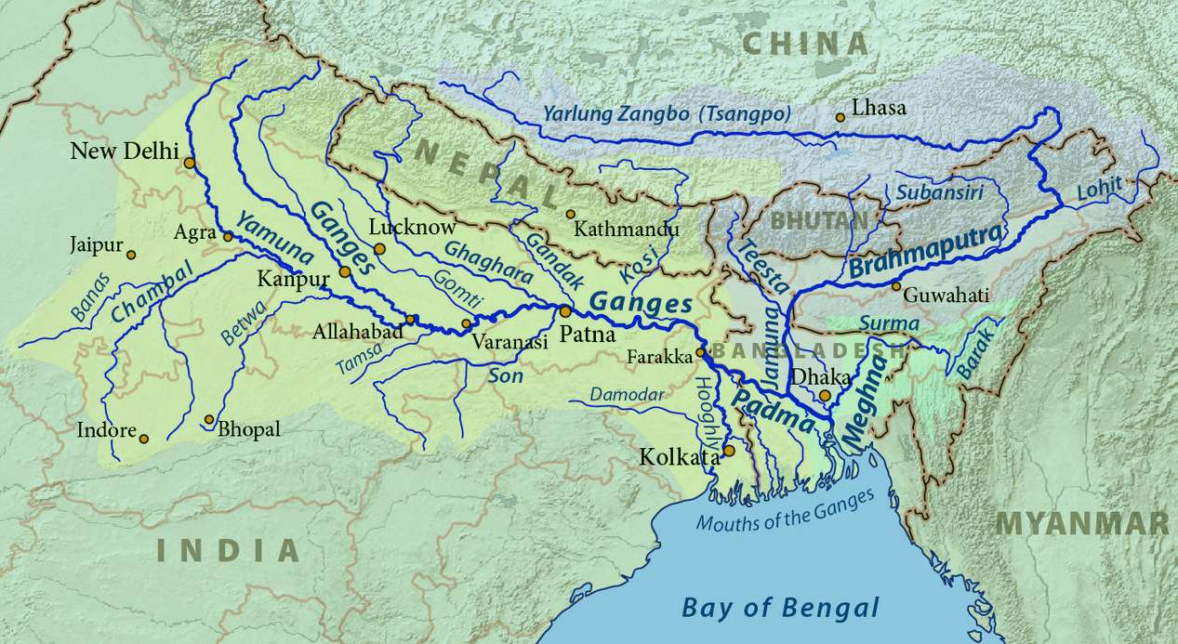
RIVER WORKHORSE
Rivers such as the Holy Mother Ganga, might benefit immediately from SeaVax survey and waste data patrols.
The Ganges is navigable for around 1,450 miles from Allahabad to the Bay of Bengal.
Once waste areas are known in any river with geographic precision, BMS might recommend and develop workable solutions.

Slide 5
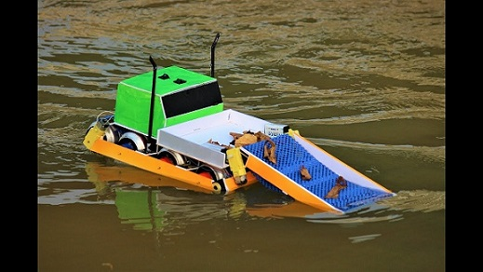
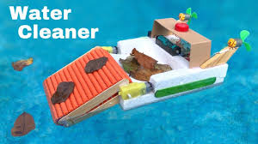
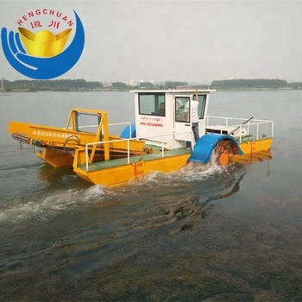
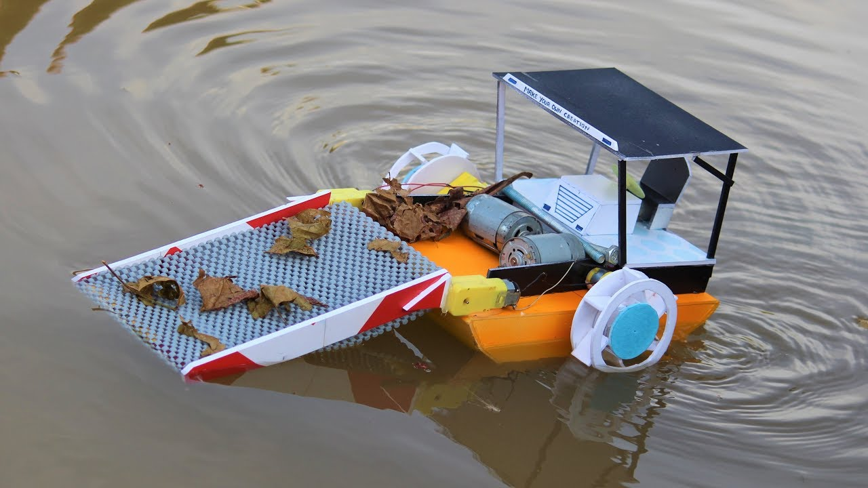
IMAGES OF W-BOT

Slide 6
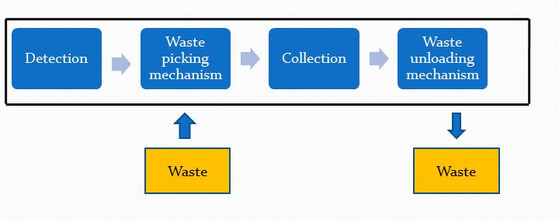
WORKING OF WATER CLEANING BOAT

Slide 7
WORKING MECHANISM:
Detection: The process of detection of wastes is done using a proper motion sensor or by using camera of suitable pixels.
Waste picking mechanism: It drags the wastes in the collecting tank which are being detected.
Collection: There should not be any leakages in the collecting box.
Waste unloading mechanism: When the capacity of collecting tank exceeds its predetermined collecting limit, a compact and portable unloading mechanism comes into action for removal of wastes which are being collected in the collecting box.

Slide 8
Advantages of w-bot:
Safe to use
Very less human contact with the water
Easy to dispose off the waste
Collect more amount of waste in less time
Should not harm the aquatic animals
Very efficient
Cost effective
Durable
Collect majority types of waste

Slide 9
ENGINEERING CONCEPT:
In water related projects, we must focus on various concepts related to fluid mechanics such as buoyancy, metacentric height. There will be a need to check the floatability and stability of the product in water.

Slide 10
THANK YOU
PRESENTED BY : DYNAMIC CREATORS

